Slide 1
Diagnosis of Multiple Sclerosis from Brain MRI and Segmentation of Lesions
Department of Information Technology
2019 B. Tech Project
By:
Suprotik Dey
Mimat Kasu

Slide 2
What we have covered:
What is MS?
General Brain MRI Information
Typical findings in MS affected MRI data
Our Dataset and Approach
Neural Networks - The Basics
Algorithmic Methods in Identification and Segmentation of MS
Proposed Architecture
Results

Slide 3
What is MS?
Multiple sclerosis (MS) is
the most common
inflammatory demyelinating disease
of the central nervous system in humans,
typically of ages between 20-40 years.

Slide 4

Physical Overview
Central Nervous System consists of neurons.
Fibres called axons protected by myelin sheath
Sheath is composed of protein and lipids.
Multiple sclerosis
autoimmune condition
body’s own immune cells attack this myelin sheath.

Slide 5
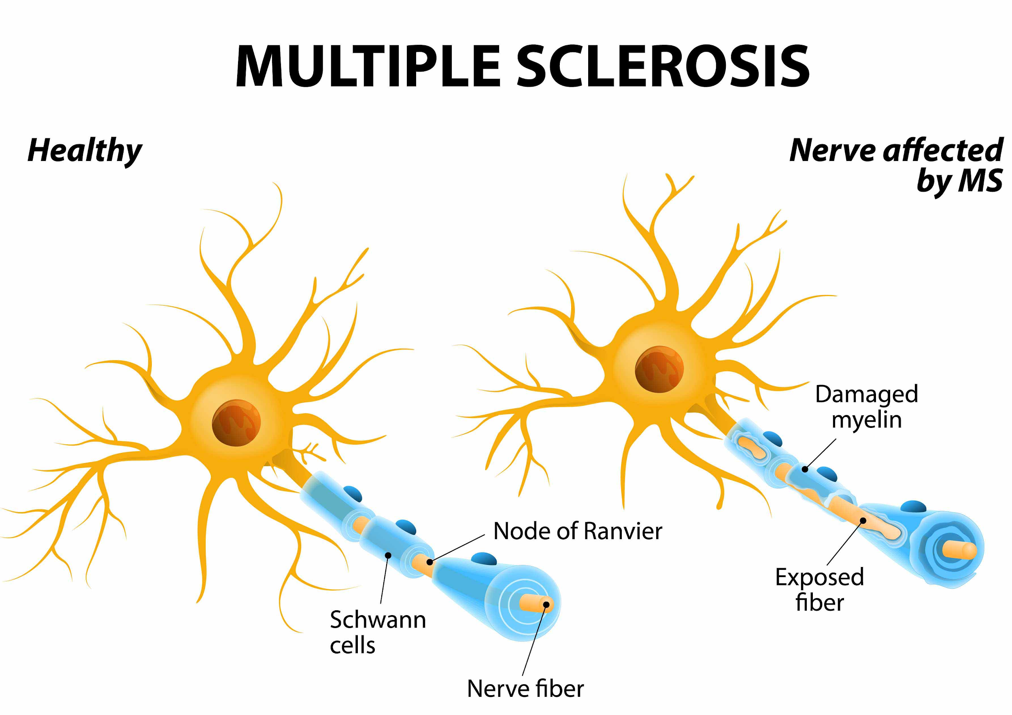
Physical Overview
Unprotected nerves
unable to properly conduct electrical impulses.
Nerve signals delayed and distorted.
Damaged myelin
forms hard scar tissue (sclerosis)
further disrupts conduction

Slide 6
Brain MRI Information and Formats

Slide 7
Common Terminology
Magnetic resonance imaging (MRI)
Repetition Time (TR) - time between successive pulse sequences applied to the same slice.
Time to Echo (TE) - time between the delivery of the RF pulse and the receipt of the echo signal.
T1-weighted images - produced by short TE and TR times. (CSF dark)
T2-weighted images are produced by longer TE and TR times. (CSF bright)
Flair (Fluid Attenuated Inversion Recovery) - Similar to T2 image except TE and TR times are very long. By doing so, abnormalities remain bright but normal CSF fluid is attenuated and made dark.

Slide 8
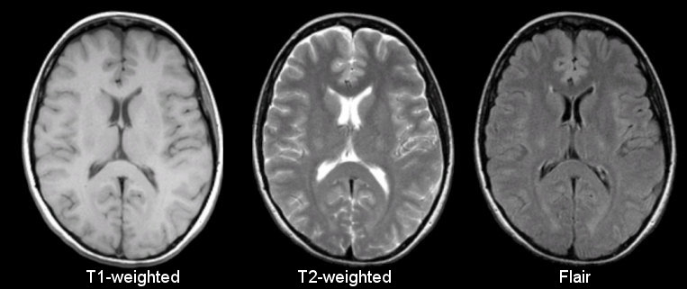
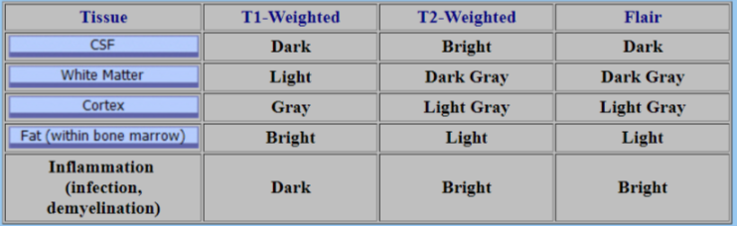

Slide 9
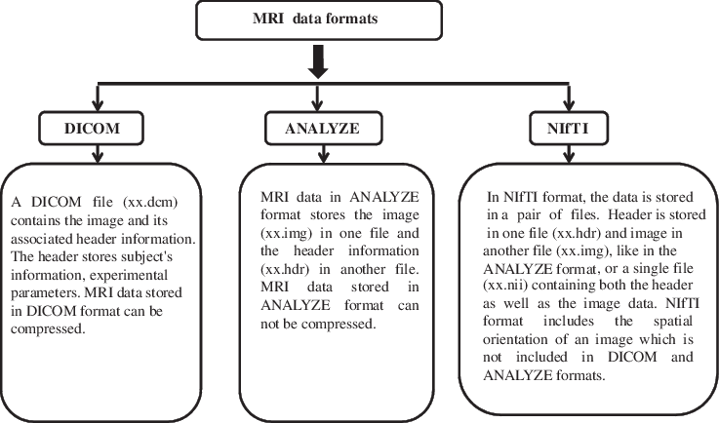

Slide 10
For More details about Nifti
https://brainder.org/2012/09/23/the-nifti-file-format/

Slide 11
Typical findings in MS affected MRI data

Slide 12
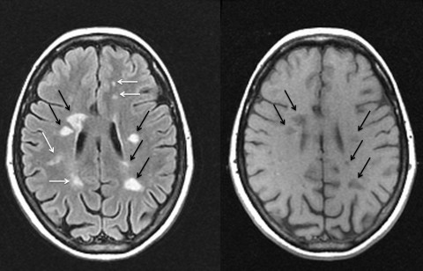
McDonald criteria for MS
Evidence of lesions (WML) disseminated in time (lesions on follow up scans) and space.
Many neurological diseases can mimic MS both clinically and radiologically.
Disappearance of these lesions into cerebrospinal fluid (CSF) is a better indicator of who will develop disability.

Slide 13
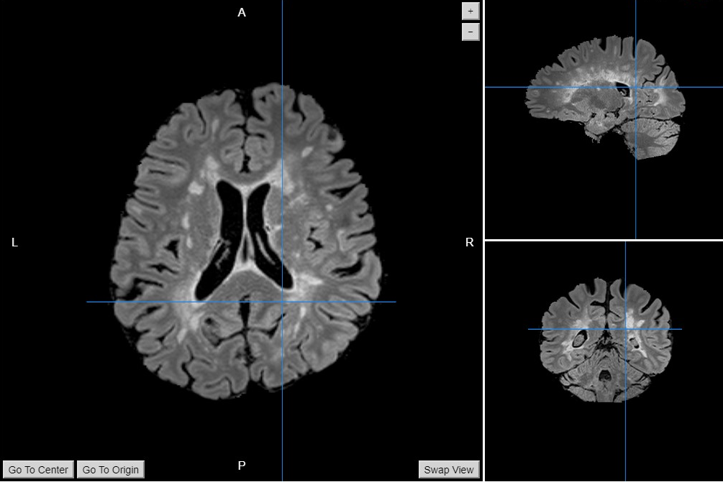

Slide 14

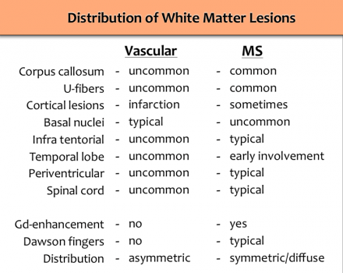
White Matter Lesions

Slide 15
Our Dataset

Slide 16
Basic Dataset Information
Source - Laboratory of Imaging Technologies
Website - http://lit.fe.uni-lj.si/tools.php?lang=eng
Name - 3D MR image database of Multiple Sclerosis patients with white matter lesion segmentations
Dataset has MRI Scans of:
30 Patients - MRI Size of 192x512x512 pixels
Brain mask
Consensus white matter lesion segmentation (Ground Truth)
Spatially co-registered and bias corrected T1, T1KS, T2, FLAIR images
RAW images (Uncorrected)
Also includes details of Patients with MS type
License: “The database is released under the Creative-Commons Attribution (CC-BY) license. Please cite the references below in any published work that uses this database”

Slide 17
Introduction to Neural Networks

Slide 18
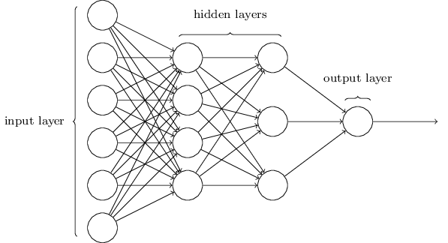
Visualizing a Neural Network

Slide 19
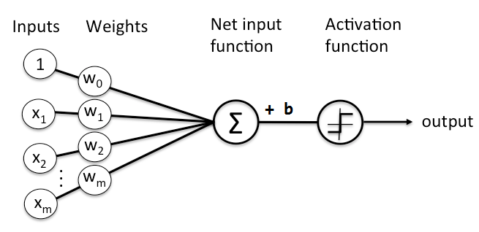
How does an artificial neuron work?
Each neuron:
Has ‘m’ inputs from previous layer
Has ‘m’ weights to be multiplied with those inputs
Has a bias value which is added
A non-linear activation function, which ‘triggers’ mimicking an actual neuron

Slide 20
How to Learn?
The neural network contains a huge number of parameters (weights, biases, etc.) which make up each individual neuron.
The model tries to find the exact parameter values which will give the correct outputs.
The model finds them out by training the model with several instances of the same type of input with their known output.
It starts off with random values of weights and biases and varies them until it gets close to the desired output by calculating the loss function, and reduce it by using an optimizer.

Slide 21
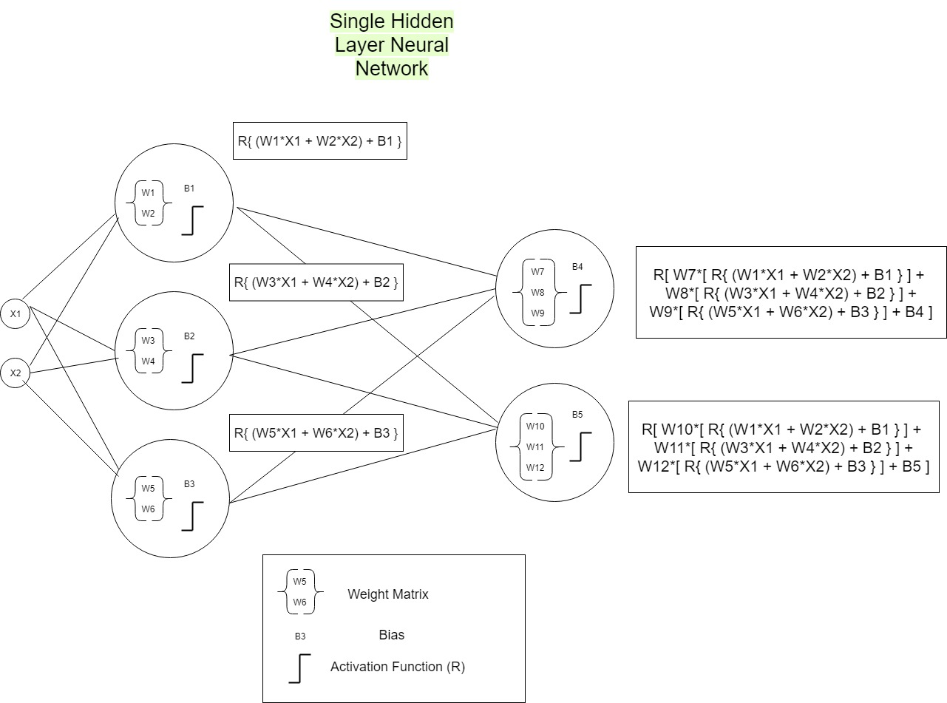

Slide 22
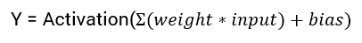
ACTIVATION FUNCTION
They basically decide whether a neuron should be activated or not. Whether the information that the neuron is receiving is relevant for the given information or should it be ignored.
The activation function is the non linear transformation that we do over the input signal. This transformed output is then sent to the next layer of neurons as input.

Slide 23
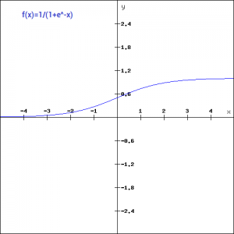
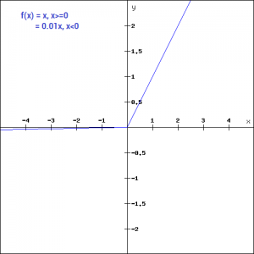
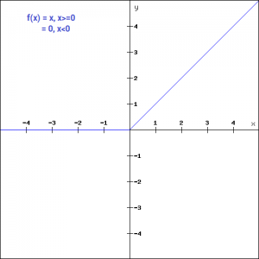
Different Activation Function
SIGMOID FUNCTION
LEAKY ReLU
ReLU FUNCTION

Slide 24
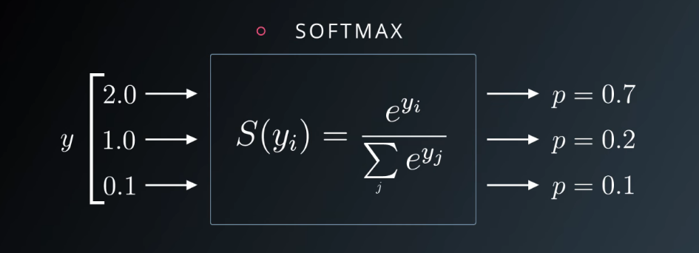
SOFTMAX
At the end of the output layer, there is a Softmax function which converts all values to probabilities.

Slide 25
LOSS FUNCTION
To optimize the neural network
the error between the labels and the outputs from the neural network is to be found out.
A simple example is mean square error : ½ ∑(L-S)2
MSE faces trouble during backpropagation so, a good example is cross entropy: ∑(Li * log(Si ))
L - Labels
S - Outputs

Slide 26
OPTIMIZER
Aim: Reduce the error found out from the loss function.
Solution: Find out the global minimum in the loss function.
Gradient descent: is a method which tells how the weights must be changed for the loss to be minimum.
Types:Vanilla Gradient Descent,SGD,ADAM,etc.
update = learning_rate * gradient_of_parameters parameters = parameters - update
The weights will be updated in the direction opposite to that of gradient because gradient points in the direction of greatest increase so we use -gradient and we take a small step in the direction of -gradient.

Slide 27

Learning Rate
Learning rate is the rate at which we will be doing the gradient descent in.
High rates can result into fast training with low rates of accuracy.
Low rates can result into slow training with higher rates of accuracy.

Slide 28
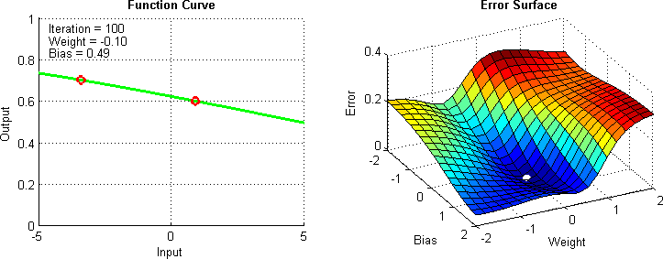
Backpropagation
On most machine learning libraries, the chain rule of differentiation is exploited to calculate the gradient descent by the optimizer.
(f(g(x))′ = f ′(g(x))*g′(x)
Thus, the individual components are fed to calculate the gradients much more efficiently by only knowing the derivatives of each individual function.
Thus, any necessity to compute complex derivatives is removed.

Slide 29
Convolutional Neural Networks

Slide 30
Why Convolutions?
Regular Neural Nets don’t scale well to full images.
An image 200x200x3, would lead to input layer neurons having 200*200*3 = 120,000 weights, stacking up to huge number of parameters.
Concept of Spatial Invariance in case of images - An object may be placed anywhere in the image.
Local connectivity is the concept of each neural connected only to a subset of the input image.

Slide 31

CONVOLUTIONS
A convolutional neural network runs a small patch through a feature set by striding few positions each time and creates a new feature map of different size and depth.

Slide 32
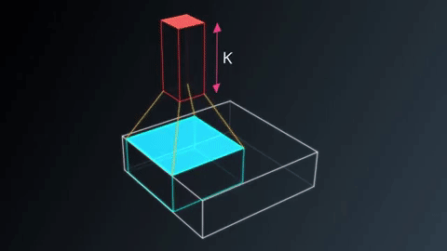
CONVOLUTIONS

Slide 33
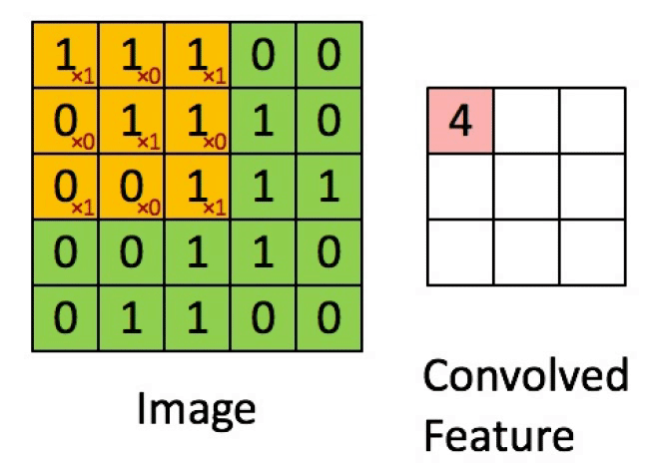
An Example CNN Layer

Slide 34
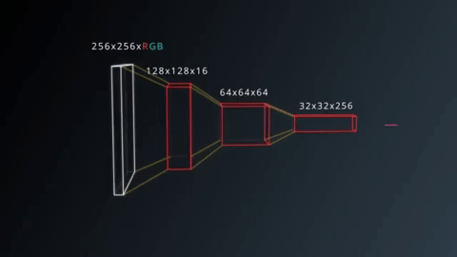
CONVOLUTIONS

Slide 35

CONVOLUTIONS
Nomenclature:
Patch or Kernel - Filter running through the image
Feature Map - Layers of output of the convolution
Stride - Amount of Shift done by the Filter
Padding:
Valid - No Padding
Same - Extra Border of Zeros Added

Slide 36
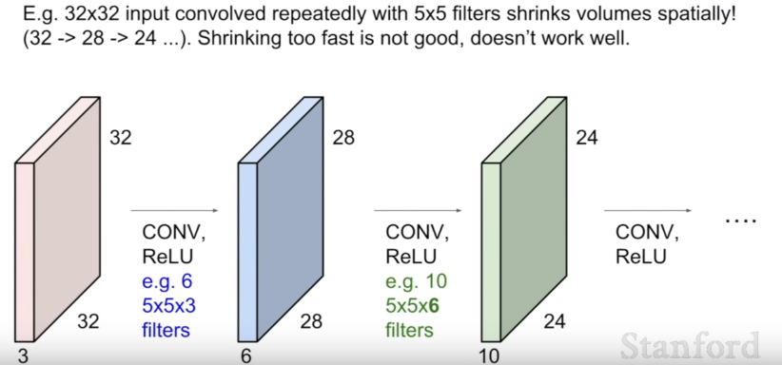
The output of the convolution operation between the filter and the input image is summed with a bias term and passed through a non-linear activation function.
The purpose of the activation function is to introduce non-linearity into our network.

Slide 37
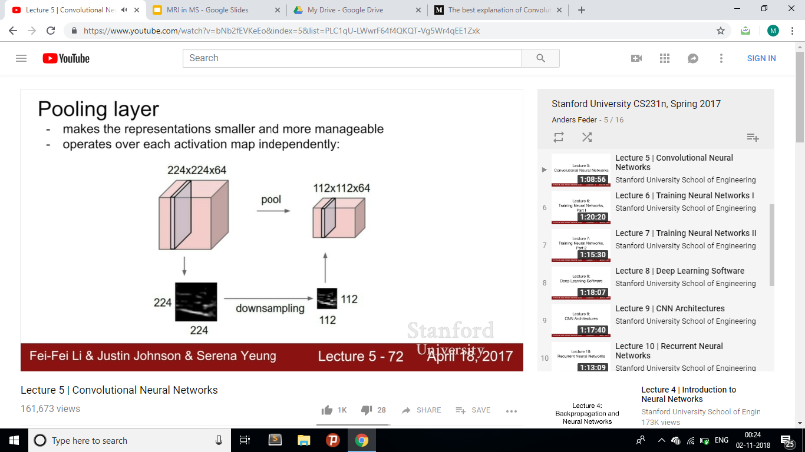
DOWNSAMPLING
To speed up the training process and reduce the amount of memory consumed by the network, we try to reduce the redundancy present in the input feature.

Slide 38
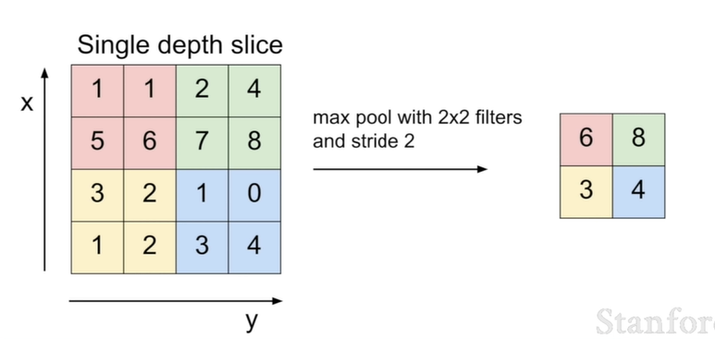
Max Pooling

Slide 39
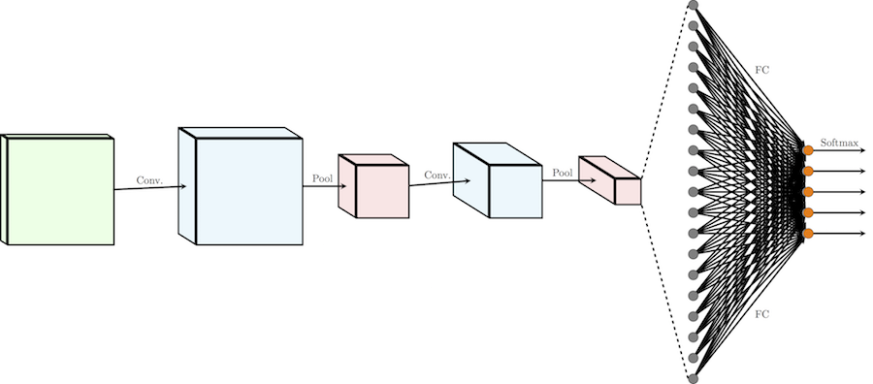
FULLY-CONNECTED LAYER
In the fully-connected operation of a neural network, the input representation is flattened into a feature vector and passed through a network of neurons to predict the output probabilities.

Slide 40
Regularization and Dropout
A model will have a low accuracy if it is overfitting.
Overfitting - Model trying too hard to capture the data points that don’t really represent the true properties of your data.
One of the ways of avoiding overfitting is using cross validation - Introduction of Validation Set to know which Hyperparameter values really work
A better regularization technique, which emerged recently, and has been very successful is dropout.
Dropout randomly drops out some of the nodes from the layers so that different redundant representations can be present to prevent overfitting.
Its like taking a consensus.
Dropout also reduces training time.

Slide 41
Autoencoders

Slide 42
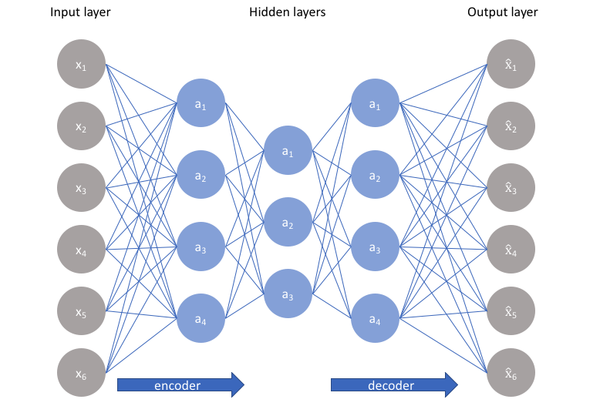
Autoencoders
A autoencoder is a neural network that has three parts:
An input layer
A middle(encoding) layer
A decoding layer

Slide 43
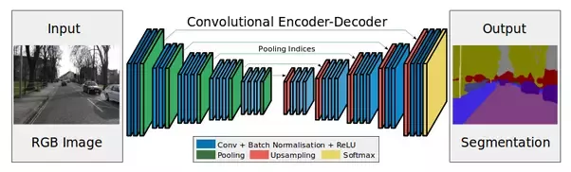
Autoencoders
The network is trained to reconstruct target inputs where middle Layer is bottlenecked
Forces the middle layer to try to learn good representations of the inputs
Pressurises the hidden layer to learn and store enough information to regenerate back its input.
Later can be retrained for objectives like:
Denoising
Segmentation
Anomaly Detection

Slide 44
General Algorithms for MS Lesion Segmentation

Slide 45
Procedure Pipeline
Input images:
DiCOM/NIFTi
Skull Removal
Denoising
Standardization and correction
Testing and Validation
Classification
Feature Extraction
ROI Masking

Slide 46
Regular Methods
Traditional Methods demand Detection of Lesions by hand by Experienced Doctors, which is tiresome and inaccessible.
Using Regular Image Processing Methods using Thresholding fail, due to huge variation in data, and its localization nature.

Slide 47
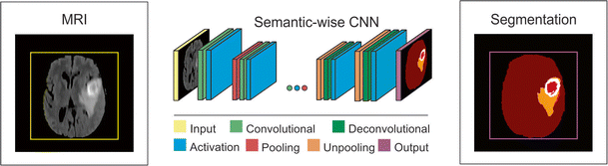
Two Paths to Follow
Algorithmic Lesion Segmentation
Preprocessing
Hand Coded lesion masking using Image Processing
MS Classification based on position of lesions
End to End Segmentation and Classification using Deep Learning
Preprocessing
End to End 3D Convolutional Neural Network Encoder-Decoder to generate Segmented MRI map
CNN to Detect if lesions imply MS.

Slide 48
End to End Segmentation and Classification using Deep Learning

Slide 49
Preprocessing
Step 1: Skull Stripping
Done by masking the main brain MRI with the skull mask
Algorithm for Skull Striping -
Take the complement of the Binary Skull Mask
Use numpy.ma.MaskedArray.filled. This function returns the original data with Zeros filled in places where the mask is True(1).

Slide 50
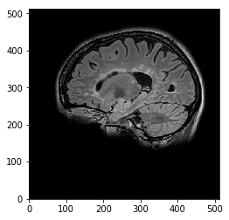
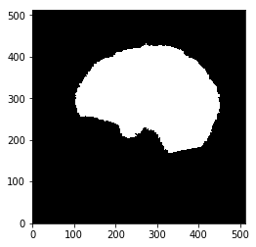
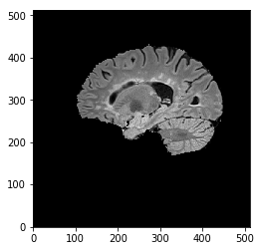
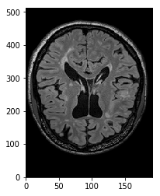
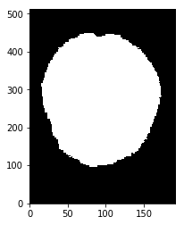
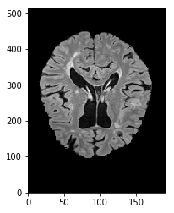
Output for Skull Stripping
Original Skull Brain-Only

Slide 51
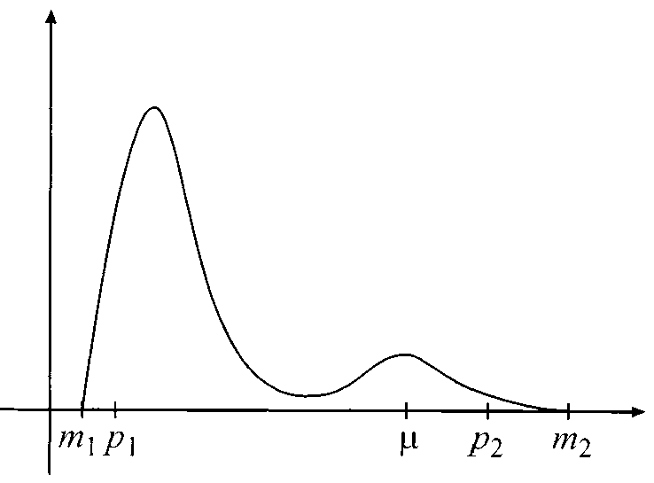
Step 2: Intensity Normalization
Aim is to get same intensities for same tissue type
The idea is to deform histogram of the image so that they match a mean histogram.
There are two steps for normalization : Training and Testing

Slide 52
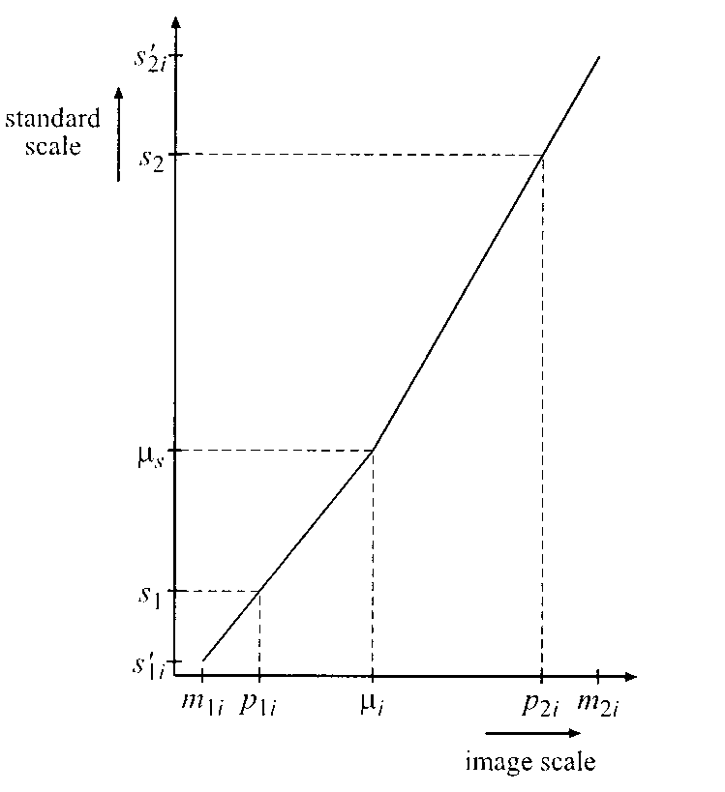
Finding Landmarks:
If x ϵ [p1,p2]
then x’ = s1 + (x-p1 ) (s2-s1)
(p2-p1)
The mode μ is mapped to μ’ and the mean of all μ’ gives μs
Transformation:
For all the images μi is mapped to μs using two linear mappings.
[p1,μi] to [s1,μs]
[μi,p2] to [μs,s2]
The following equation is used:
T(x)= μs + (x-μi) s1-μs , if m1≤ x ≤ μi
p1-μi
= μs + (x-μi) s2-μs ,otherwise
p2-μi

Slide 53
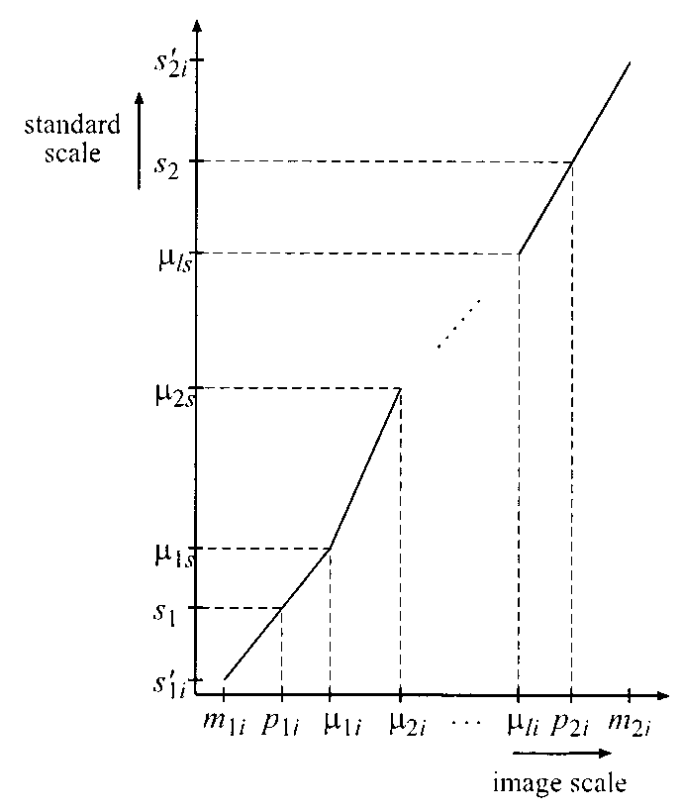
For Multiple landmarks:
We have taken standard scale from patient scan 3.Also p1=1% and p2=99%.
Landmarks are [1%,10%,20%,30%50%,70%,80%,85%,90%,99%]

Slide 54
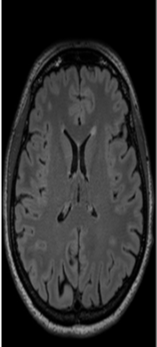
Image with Target Characteristics

Slide 55
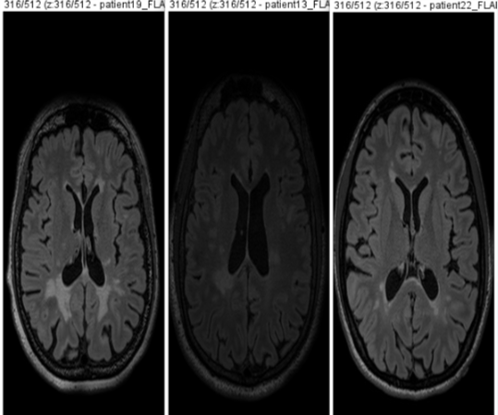
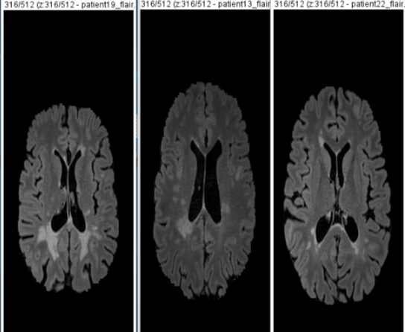
Output
of Intensity Normalization

Slide 56
Our Model:
3D Convolutional Autoencoder

Slide 57
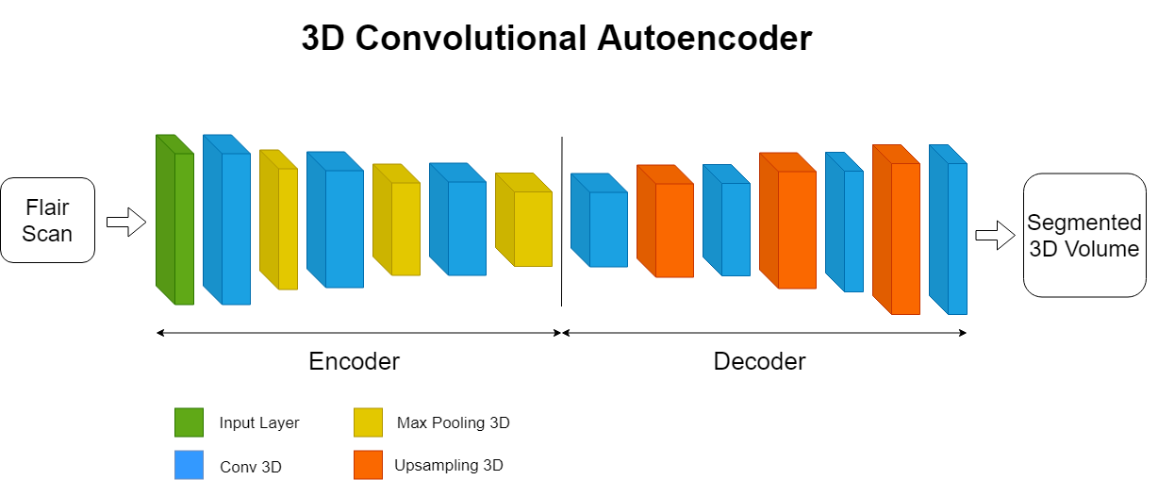

Slide 58
Some Important Libraries Used
Nibabel - a great tool in handling and formatting MRIs
Tensorflow – a neural network library.
Keras - Enables fast experimentation with deep neural networks, it focuses on being user-friendly, modular, and extensible.
Matplotlib - Matplotlib is a Python 2D plotting library
Glob - For Path listing of Directories
Google Colab - A free cloud service and now it supports free GPU.
Papaya Viewer - Papaya is a JavaScript medical image viewer, supports DICOM and NIFTI formats.
Fiji - Fiji is an open source image processing package to View MRIs.

Slide 59
Hardware Used
The Model developed has been trained on Google Colab Platform. The Hardware available are:
CPU - 1x single core hyper threaded i.e (1 core, 2 threads) Xeon Processors @2.3Ghz (No Turbo Boost) , 45MB Cache
GPU - Tesla T4 :- CUDA Version: 10.0 VRAM: 15079MiB ⇌ 15GB
RAM - 12.6 GB Available
HDD - 320 GB Available

Slide 60
Procedure for Basic Lesion Segmentation
Take FLAIR scans
Do Skull Stripping
Do Contrast enhancing and Normalization Preprocessing
Run through multiple layers of convNets and max poolings
Constriction created to restrict irrelevant data
Pass through a Deconvolution Network
Pass through Binariser

Slide 61
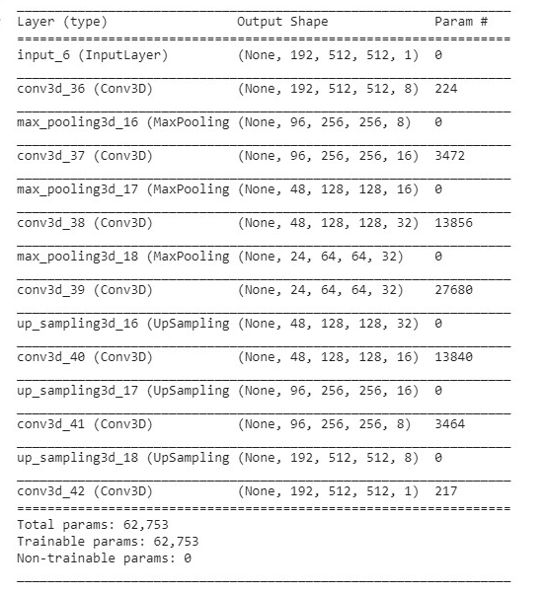
Model
Definition

Slide 62
HyperParameters Used
Model_input_size = (192, 512, 512, 1)
Total_epochs = 400
Epochs_per_item = 10
Learning_rate = 0.0001
Batch_size = 1
Optimizer used: Adam
Activation for each CNN: ReLu

Slide 63
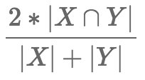
Few Algorithms and Formulas
Dice score = (2*number of true positives ) / (2*number of true positives + number of false positives + number of false negatives)
We have used Dice Score Loss
Why not a Simple MSE as Loss?
The Goal Segmentation generally has very few true(one) values.
Using MSE as loss fails, since it reaches a local optimum, with output all zeros.

Slide 64
The Result

Slide 65
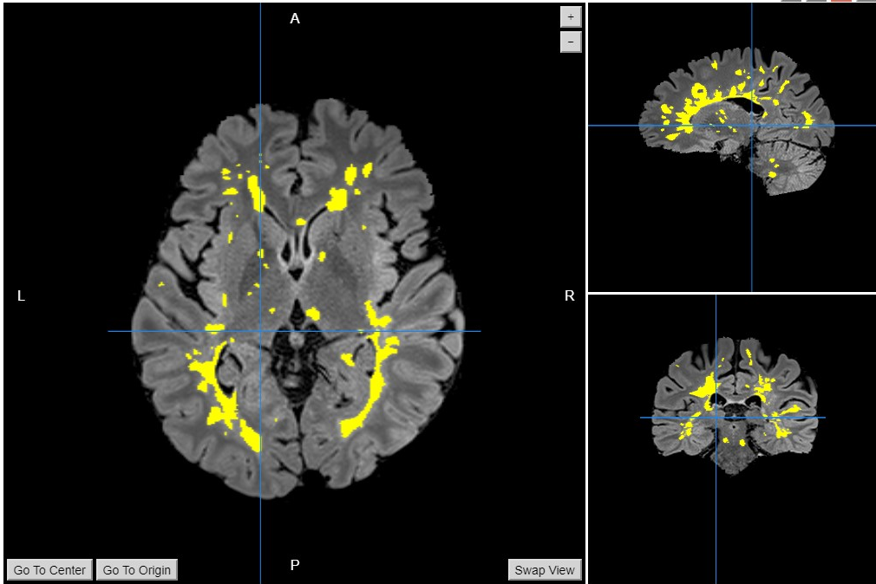
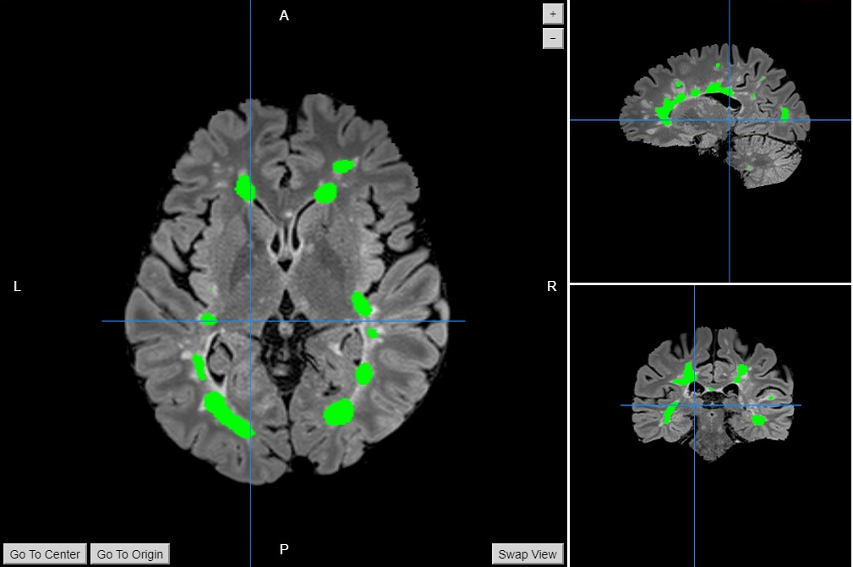
Output By Model (Binarised)
Consensus Label

Slide 66
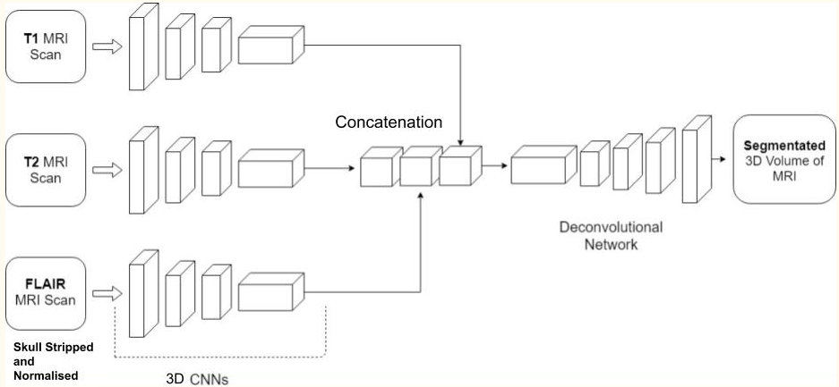
Future Works
Instead of giving only the flair images as input, all the 3 types of MRI can be given as input so as to get a better output.We have proposed a model for that as well. It is as follows:
Due to lack of required RAM size, we could work with a batch size of 1. A larger batch size would give better results. So we will try to train our model on a larger RAM with a greater batch size.
Once that is completed, we can build a fully automated tool and deploy it on the cloud.
We will also build a REST API to interface and call our model.

Slide 67
Lets see some code and data!

Slide 68
References
http://www.radiologyassistant.nl/en/p4556dea65db62/multiple-sclerosis.html
https://www.slideshare.net/mandypannu21/neurons-structure-and-nerve-impulse
https://www.youtube.com/watch?v=Naecv3h868c
http://casemed.case.edu/clerkships/neurology/web%20neurorad/mri%20basics.htm
https://en.wikipedia.org/wiki/Multiple_sclerosis
https://www.news-medical.net/health/Myelin-Function.aspx
https://www.youtube.com/watch?v=yzH8ul5PSZ8
http://cs231n.github.io/convolutional-networks/
https://github.com/sergivalverde/nicMSlesions
https://www.ncbi.nlm.nih.gov/pubmed/10571928
https://github.com/jcreinhold/intensity-normalization/blob/master/tutorials/5min_tutorial.md

Slide 69


Thank you

